Slide 1

CAP444 OBJECT ORIENTED PROGRAMMING USING C++
Session #1

Slide 2
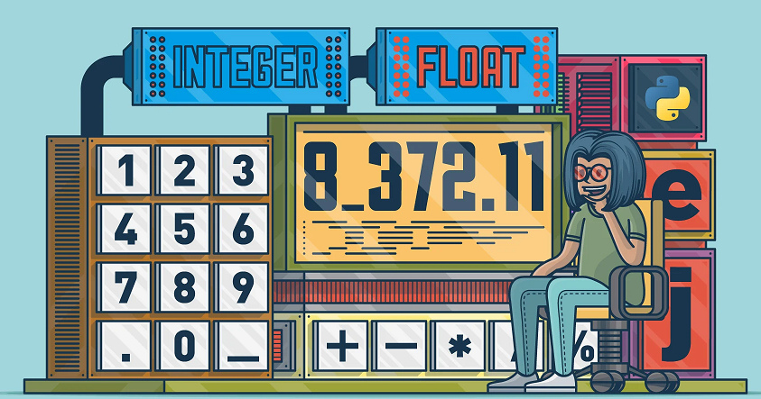

Topics Covered…
Basic concepts of object oriented programming

Slide 3
Data types
User-define type
Built-in-type
Derived type
Integer
Character
Boolean
Floating Point
Double
Void
Wide Character
Class
Structure
Union
Enum
Typedef
Function
Array
Pointer
Reference

Slide 4
Primitive Data Types: These data types are built-in or predefined data types and used to declare variables.
Primitive data types available in C++ are:
Integer(int)
Character(char)
Boolean(bool)
Floating Point(float)
Double Floating Point(double)
Valueless or Void(void)
Wide Character(wchar_t)

Slide 5
Wide Character: Wide character data type is also a character data type but this data type has size greater than the normal 8-bit datatype.

Slide 6
Derived Data Types: The data-types that are derived from the primitive or built-in datatypes are referred to as Derived Data Types.
These are:
Function
Array
Pointer
Reference

Slide 7
Abstract or User-Defined Data Types: These data types are defined by user itself.
Class
Structure
Union
Enumeration or Enum
Typedef

Slide 8
Data type | Size(in byte) | Range
char | 1 =8 bits ( 2⁸ ) | -128 to 127 or 0 to 255
unsigned char | 1 | 0 to 255
signed char | 1 | -128 to 127
int | 4=32 bits ( 2³² ) | -2,147,483,648 to 2,147,483,647
short int | 2 | -32,768 to 32,767
unsigned short int | 2 | 0 to 65,535
unsigned int | 4 | 0 to 4,294,967,295
float | 4
double | 8
long double | 12
We can display the size of all the data types by using the sizeof() operator

Slide 9
Memory representation
1 Byte= 8 Bits
128 0 | 64 1 | 32 0 | 16 0 | 8 0 | 4 0 | 2 0 | 1 1
A(65)=01000001
char ch=65;
Or
char ch=‘A’
Char is occupying 1 Byte memory

Slide 10
How to find out range?
For Signed data types:
1.) calculate total number of bits
2.) Calculate -2^(n-1) for minimum range
3.) Calculate (2^(n-1))-1 for maximum range
Unsigned Data Types:
1.)Find number of bits
2.)minimum range is always zero for unsigned data type
3.)for maximum range calculate 2^n-1

Slide 11
Example:
Char : 1 byte: 8 bits=n
Signed: -2⁽⁸⁻¹⁾ to (2⁽⁸⁻¹⁾)-1
=-128 to 127
Unsigned:
0 to 2⁽⁸⁾-1
^{=0 to 255}

Slide 12
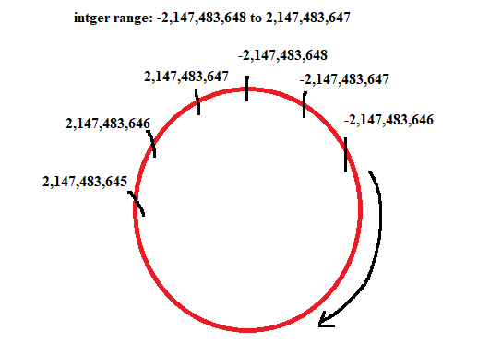
Exceeding range…?

Slide 13
What will be output?
#include <iostream>
using namespace std;
int main()
{
int num=2147483648;
cout <<num<< endl;
return 0;
}
2147483648
- 2147483648
Error
None

Slide 14
Data type modifiers are:
Signed
Unsigned
Short
Long

Slide 15
Operators
Arithmetic operators
Assignment operators
Comparison operators
Logical operators
Bitwise operators
Increment /decrement operators
insertion operator/ extraction operator

Slide 16
Arithmetic operators
Operator | Name | Example
+ | Addition | x + y
- | Subtraction | x - y
* | Multiplication | x * y
/ | Division | x / y
% | Modulus | x % y

Slide 17
Assignment Operators
Operator | Example | Same As
= | x = 5 | x = 5
+= | x += 3 | x = x + 3
-= | x -= 3 | x = x - 3
*= | x *= 3 | x = x * 3
/= | x /= 3 | x = x / 3
%= | x %= 3 | x = x % 3
&= | x &= 3 | x = x & 3
|= | x |= 3 | x = x | 3
^= | x ^= 3 | x = x ^ 3
>>= | x >>= 3 | x = x >> 3
<<= | x <<= 3 | x = x << 3

Slide 18
Comparison operators
Operator | Name | Example
== | Equal to | x == y
!= | Not equal | x != y
> | Greater than | x > y
< | Less than | x < y
>= | Greater than or equal to | x >= y
<= | Less than or equal to | x <= y

Slide 19
Logical operators
Operator | Name | Description | Example
&& | Logical and | Returns true if both statements are true | x < 5 && x < 10
|| | Logical or | Returns true if one of the statements is true | x < 5 || x < 4
! | Logical not | Reverse the result, returns false if the result is true | !(x < 5 && x < 10)

Slide 20
Bitwise operators
Operator | Description
& | AND Operator
| | OR Operator
^ | XOR Operator
~ | Ones Complement Operator
<< | Left Shift Operator
>> | Right Shift Operator

Slide 21
AND Operator (&)
If both side bit is on result will be On
a | b | a & b
0 | 0 | 0
0 | 1 | 0
1 | 0 | 0
1 | 1 | 1

Slide 22
Steps to solve:-
a = 12 (find binary form:1100 )
b = 25 (find binary form:11001)
How to find Binary:
64 32 16 8 4 2 1
0 1 1 0 0
12
25
8
1 1 0 0 1
1 0 0 0

Slide 23
a & b=
01100 (12)
11001 (25)
01000 (8) Ans.

Slide 24
What will be output?
#include <iostream>
using namespace std;
int main()
{
int a=20;
int b=25;
cout<<(a&b);
return 0;
}
15
16
20

Slide 25
OR Operator (|)
If any side bit is on result will be On
a | b | a | b
0 | 0 | 0
0 | 1 | 1
1 | 0 | 1
1 | 1 | 1

Slide 26
Steps to solve:-
a = 12 (find binary form:1100 )
b = 25 (find binary form:11001)
How to find Binary:
64 32 16 8 4 2 1
0 1 1 0 0
12
25
29
1 1 0 0 1
1 1 1 0 1

Slide 27
a | b=
01100 (12)
11001 (25)
11101 (29) Ans.

Slide 28
What will be output?
#include <iostream>
using namespace std;
int main()
{
int a=20;
int b=15;
cout<<(a|b);
return 0;
}
31
32
22
32

Slide 29
XOR Operator (^)
If both side bit is opposite result will be On
a | b | a | b
0 | 0 | 0
0 | 1 | 1
1 | 0 | 1
1 | 1 | 0

Slide 30
Steps to solve:-
a = 12 (find binary form:1100 )
b = 25 (find binary form:11001)
How to find Binary:
64 32 16 8 4 2 1
0 1 1 0 0
12
25
21
1 1 0 0 1
1 0 1 0 1

Slide 31
a ^ b=
01100 (12)
11001 (25)
10101 (21) Ans.

Slide 32
Left Shift Operator(<<)
a=10 (1010)
a<<1
1010.0
10100(20) Ans.
a<<2
1010.00
101000(40) Ans.

Slide 33
Right Shift Operator(>>)
a=10 (1010)
a>>1
1010.
101(5) Ans.
a>>2
1010.
10(2) Ans.

Slide 34
What will be output?
#include <iostream>
using namespace std;
int main()
{
int a=15;
cout<<(a>>1);
return 0;
}
Options:
5
6
7
8

Slide 35
++
Increment
++x
--
Decrement
--x

Slide 36
insertion operator(<<):
The cout is used in conjunction with stream insertion operator (<<) to display the output on a console
extraction operator (>>):
The cin is used in conjunction with stream extraction operator (>>) to read the input from a console.

Slide 37
Control structure
Conditional structure: if and else
Selective structure: switch case
Iteration structures (loops): while, do while, for
Jump statements: break, continue, goto

Slide 38
Conditional structure
if(condition)
{
//statement
}
else
{
//statement
}

Slide 39
Any Query?

